Slide 1

Task 26
Analysis chinook database
Name: Basel Amr Barakat
Email: baselamr52@gmail.com

Slide 2
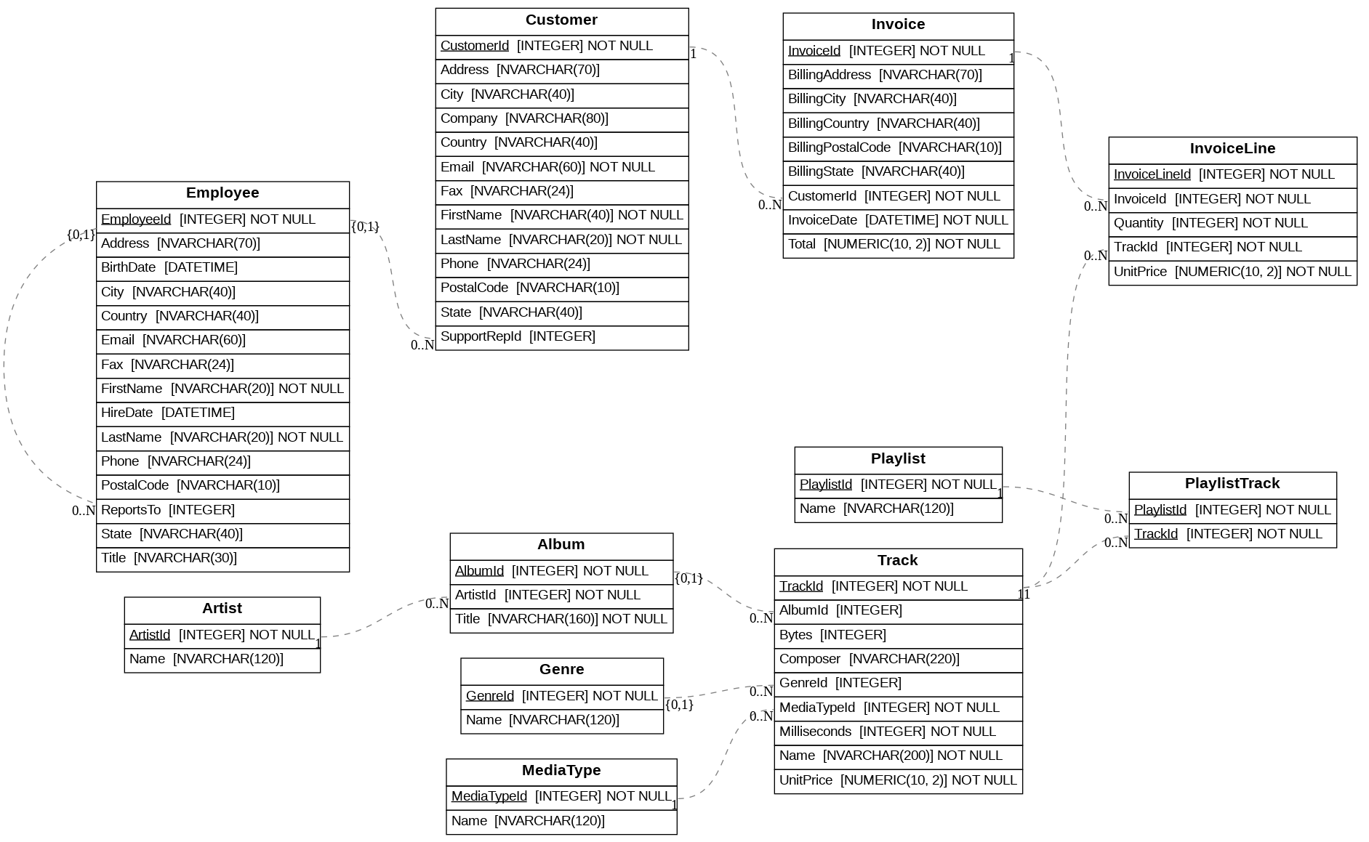
Database Design

Slide 3
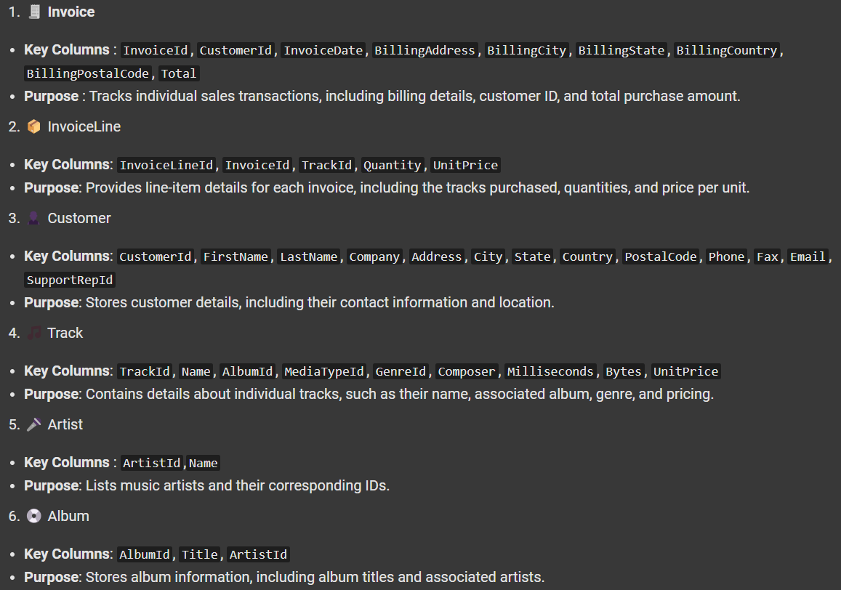
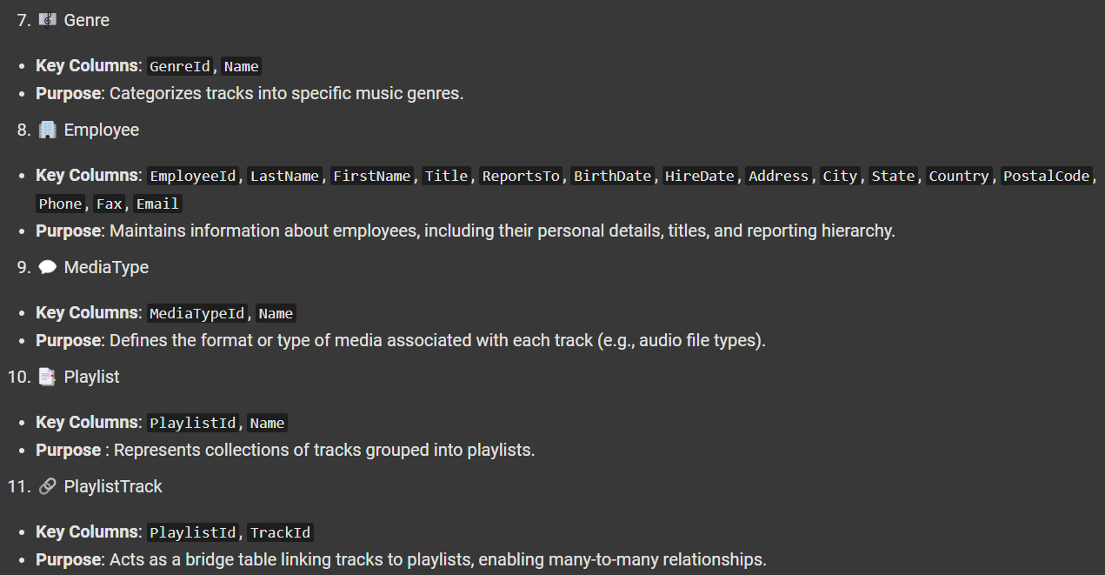
Database Overview

Slide 4
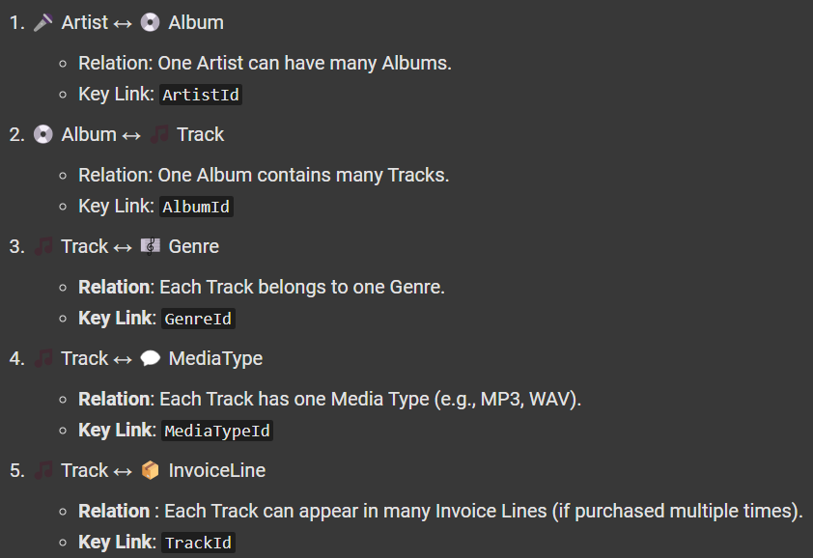
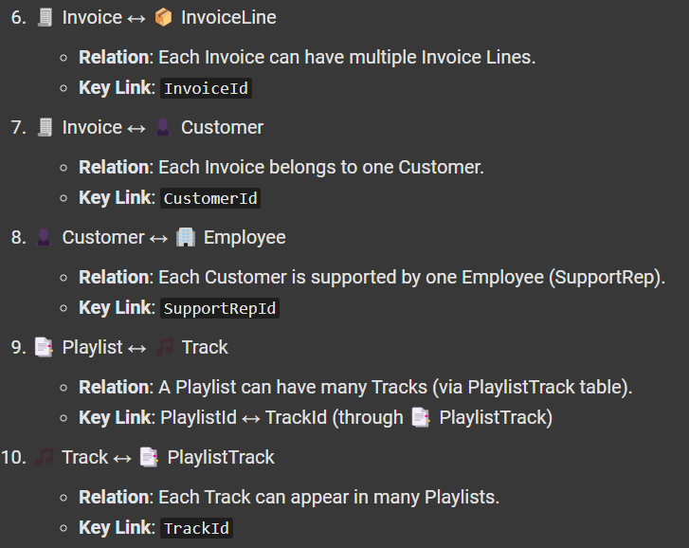
Database Relationship Overview

Slide 5
Requirement One
Complex Joins and CTEs

Slide 6
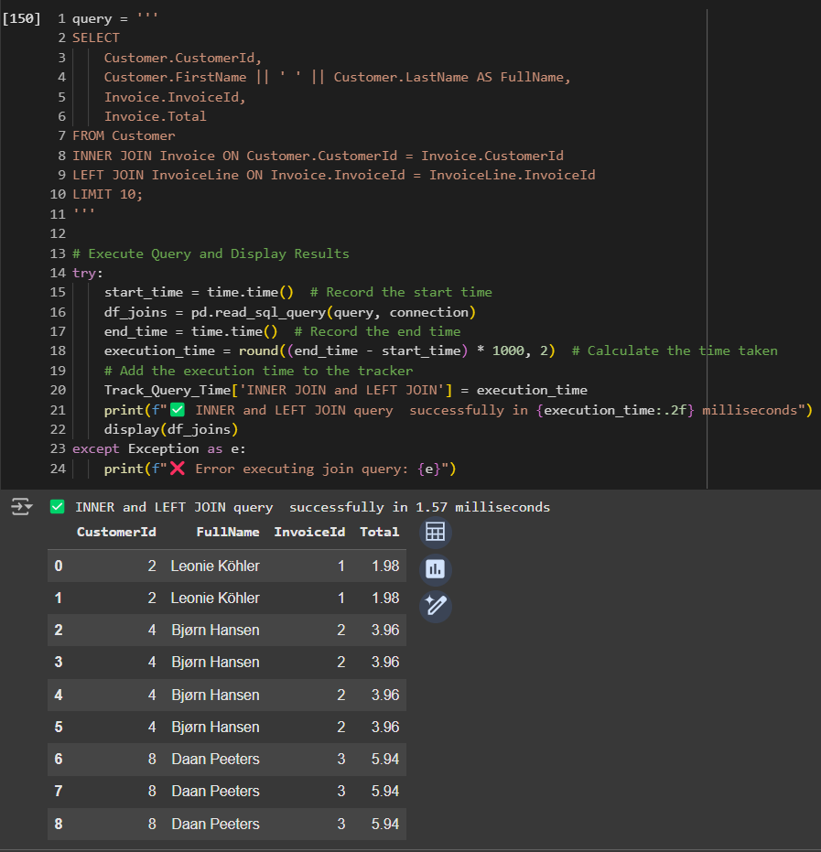
1.1 Use Inner JOIN and LEFT JOIN to combine Customer, Invoice and InvoiceLine

Slide 7
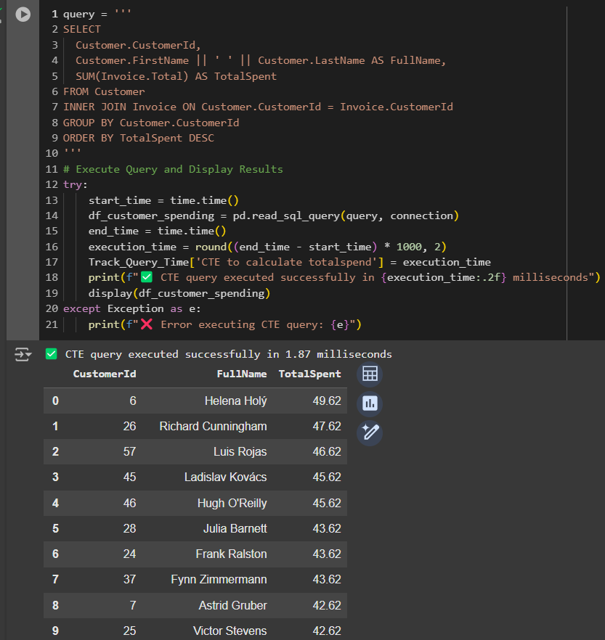
1.2 Use a CTE to calculate total amount spent by each customer

Slide 8
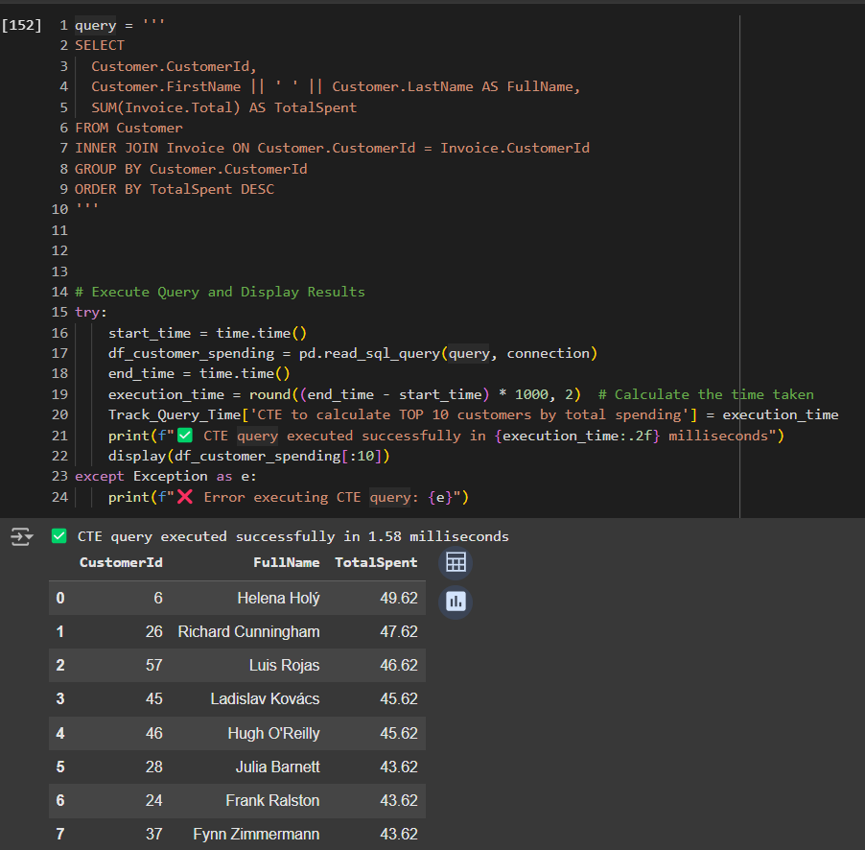
1.3 Calculate the top 10 customers by total spending

Slide 9
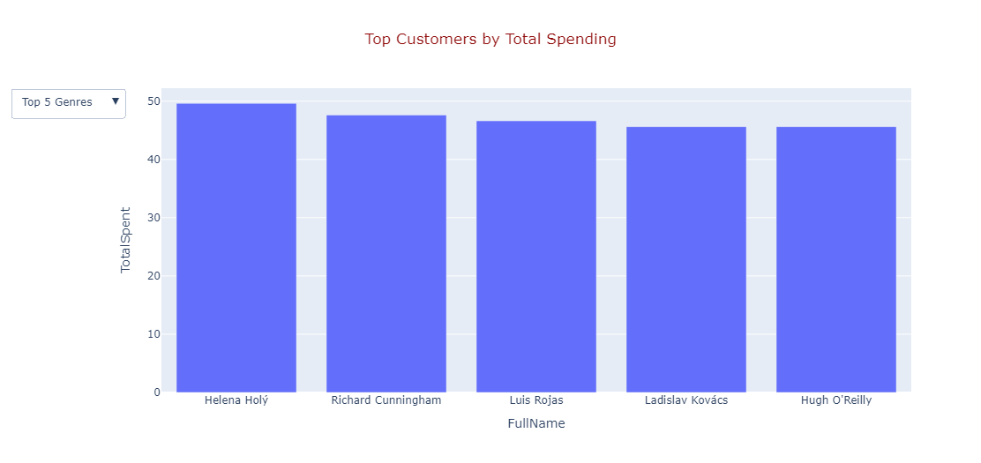
1.4 Visualizations

Slide 10
Requirement Two
Window Functions for Ranking

Slide 11
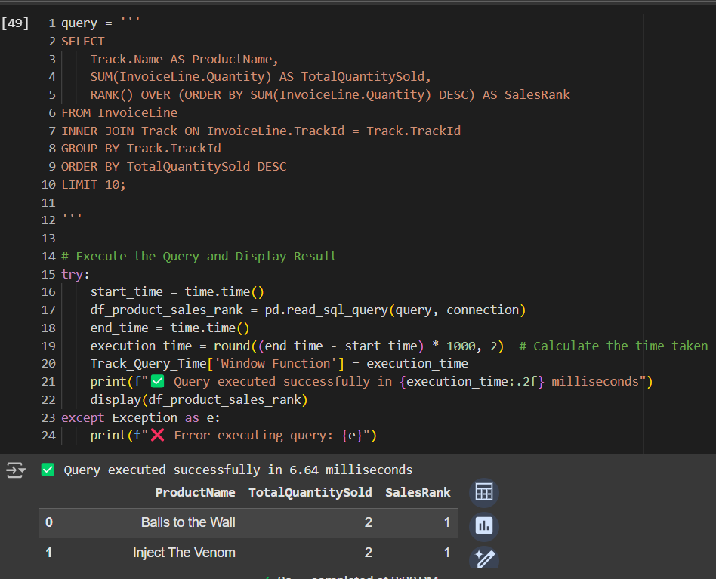
2.1 Calculate the rank of each product by total sales amount

Slide 12
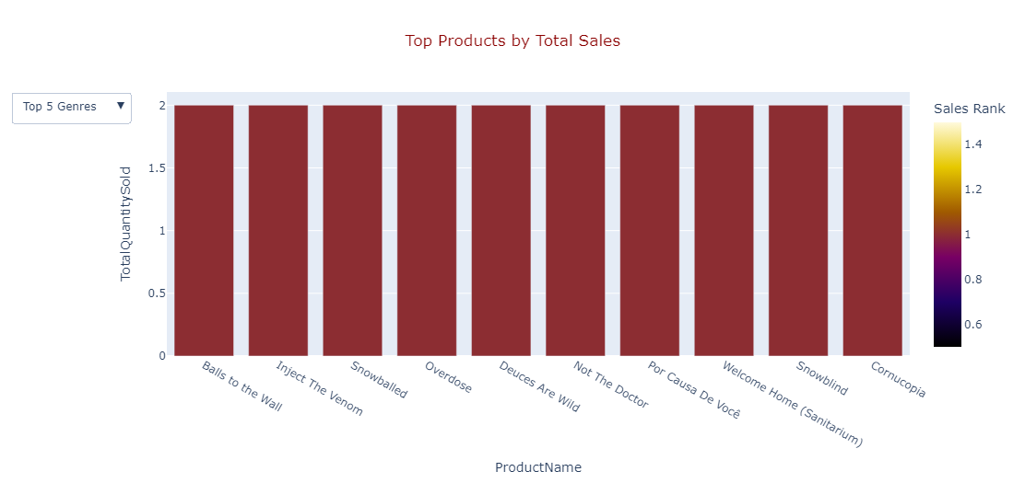
Visualizations

Slide 13
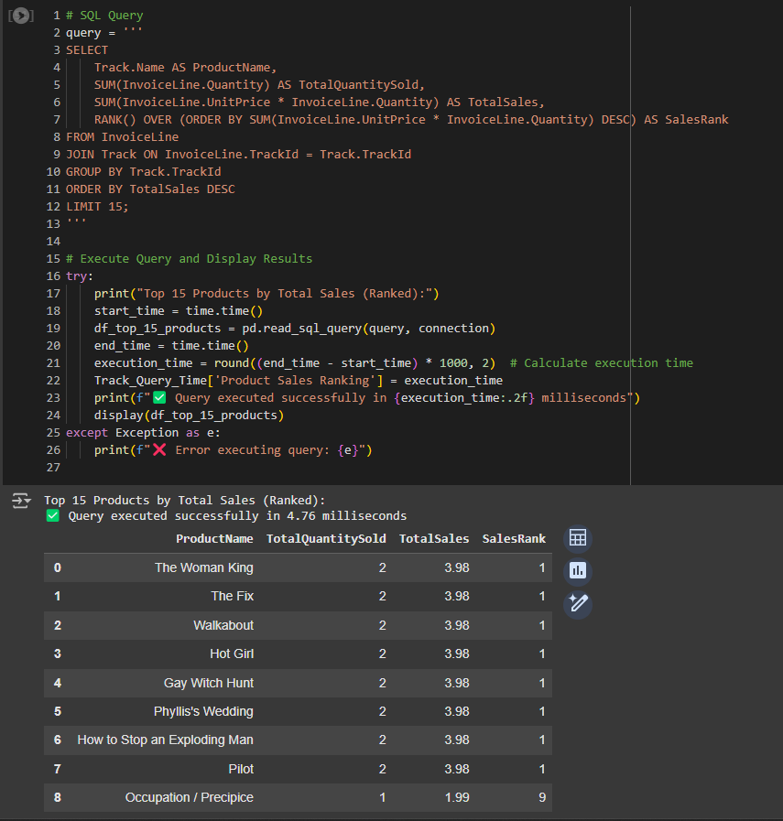
2.2 Identify the top selling products in the database using ROW to rank top selling products

Slide 14
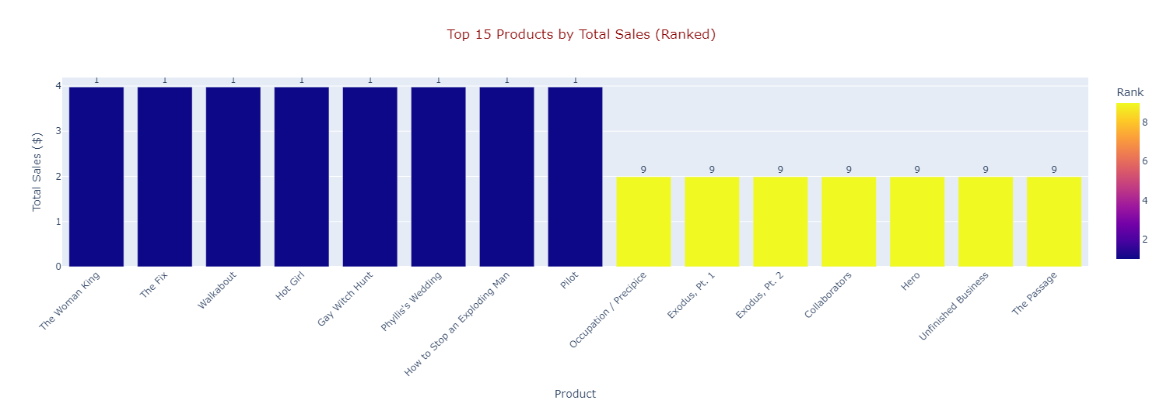
Visualizations

Slide 15
Requirement Three
Indexing and Performance Optimization

Slide 16
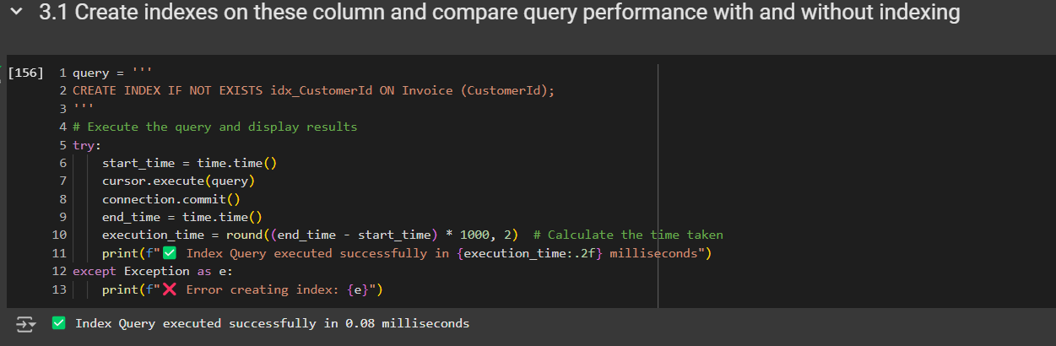
3.1 Create indexes on these columns and compare query performance with and without

Slide 17
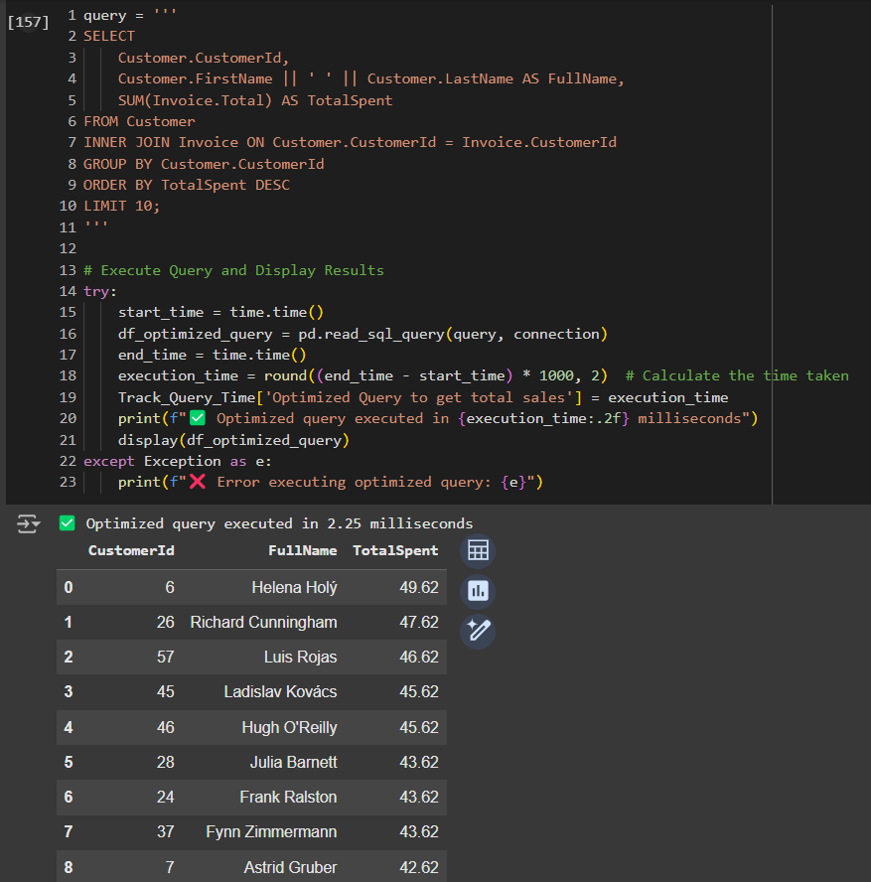
3.2 Write a query that lists total sales for each customer and optimize it using indexing

Slide 18
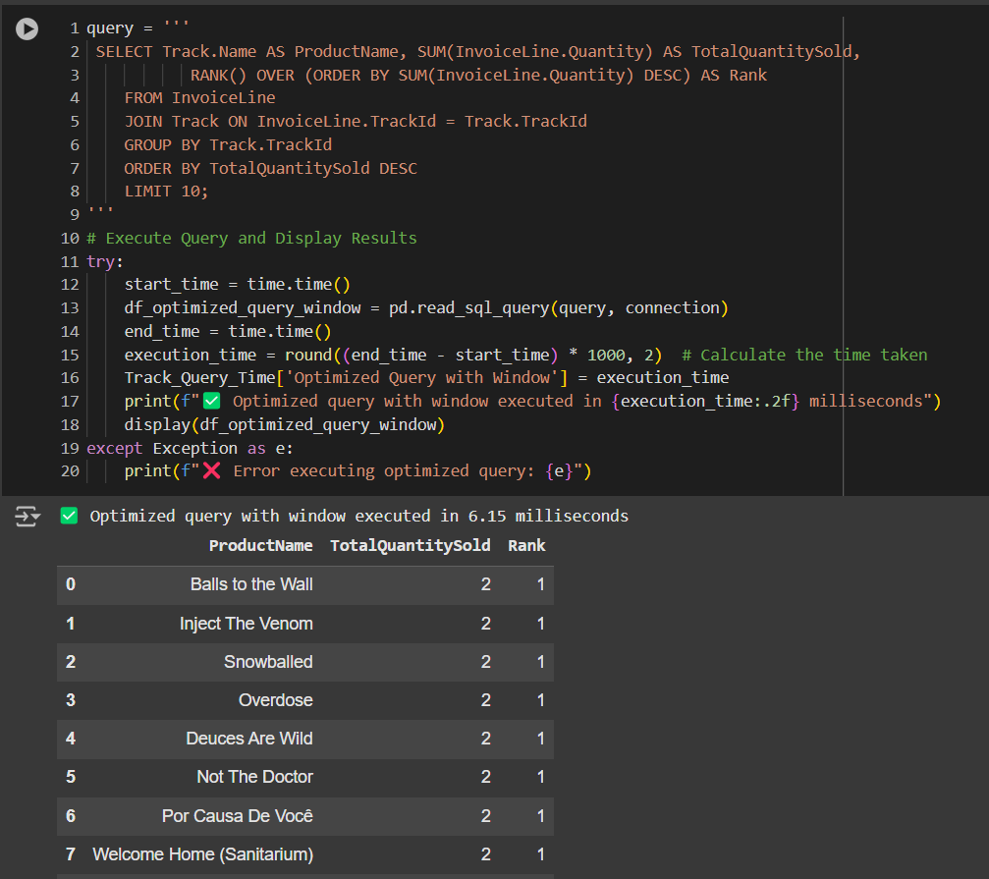
3.3 Write a query that makes window after indexing

Slide 19
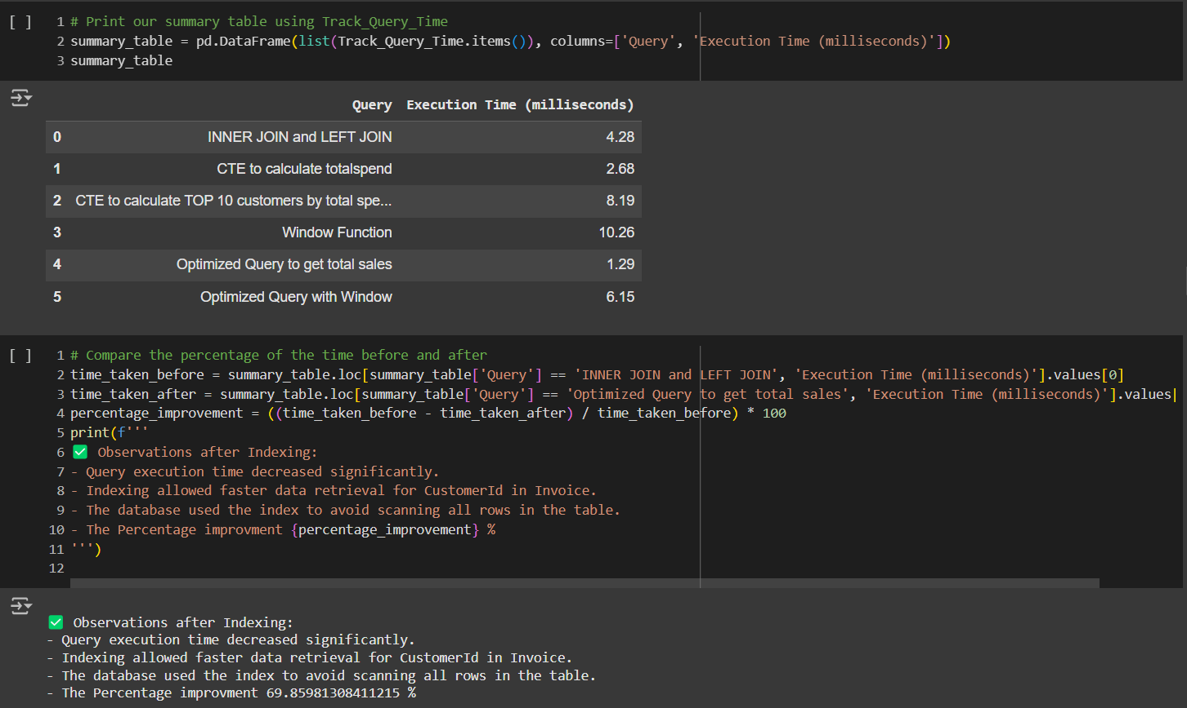
3.4 Summary

Slide 20
Requirement Four
New Requirements and Ideas

Slide 21
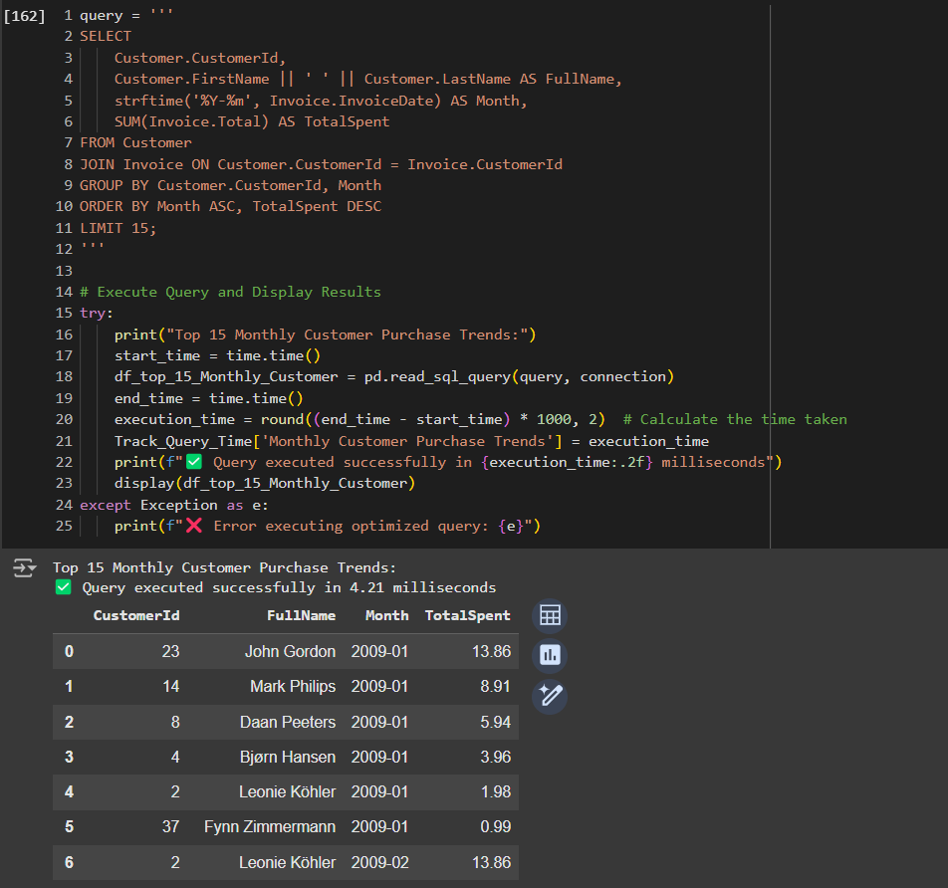
4.1 Customer Purchase Trends Over Time

Slide 22
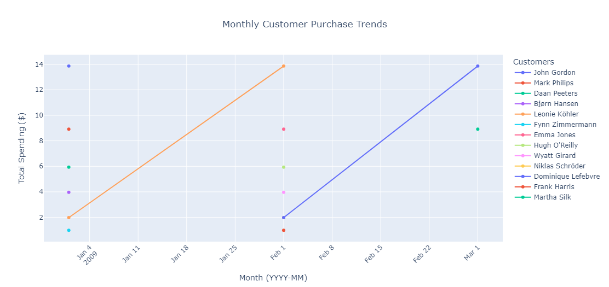
4.1 Visualizations

Slide 23
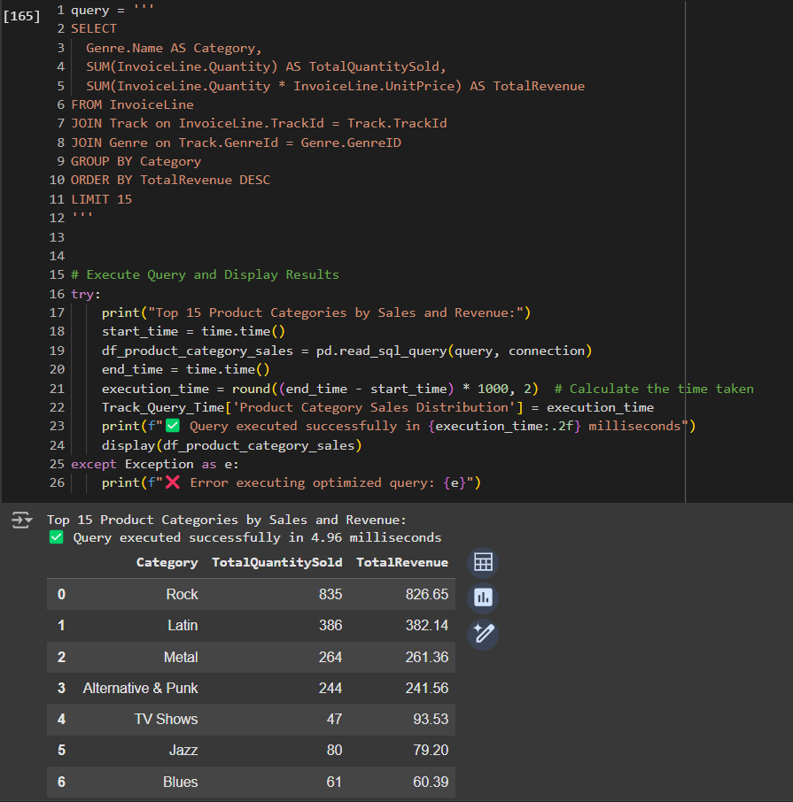
4.2 Product Affinity Analysis

Slide 24
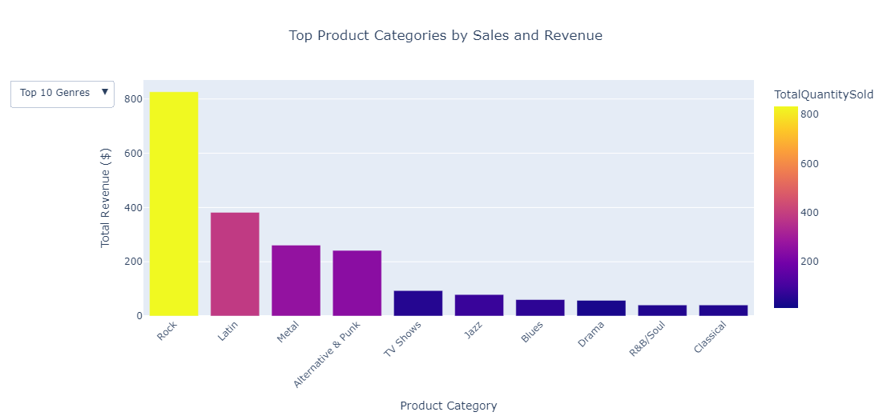
4.2 Visualizations

Slide 25
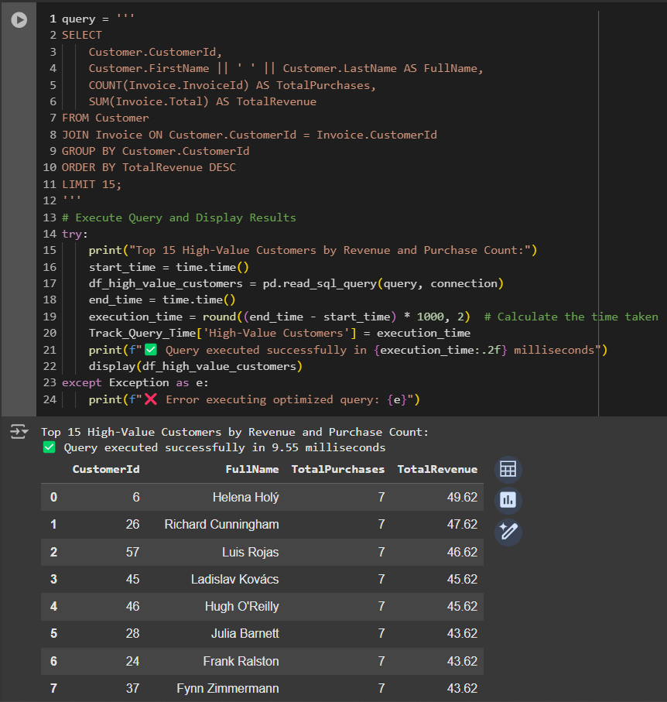
4.3 Customer Segmentation (RFM Analysis)

Slide 26
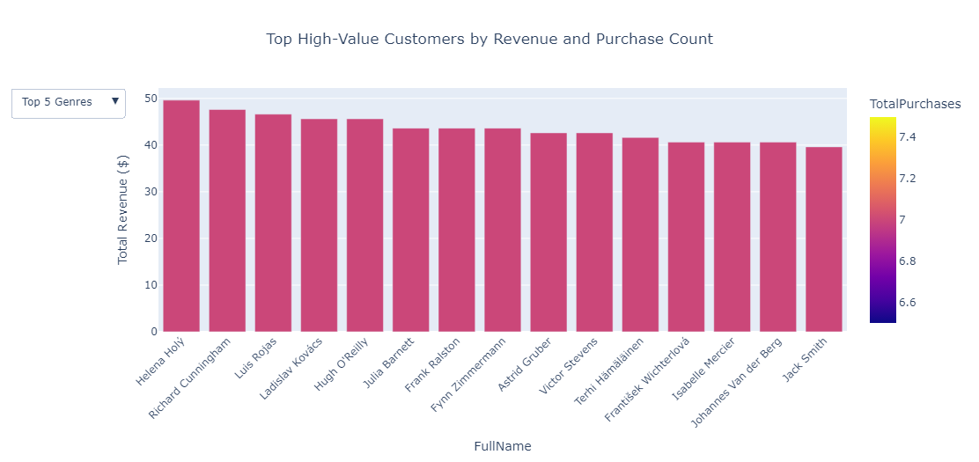
4.3 Visualizations

Slide 27
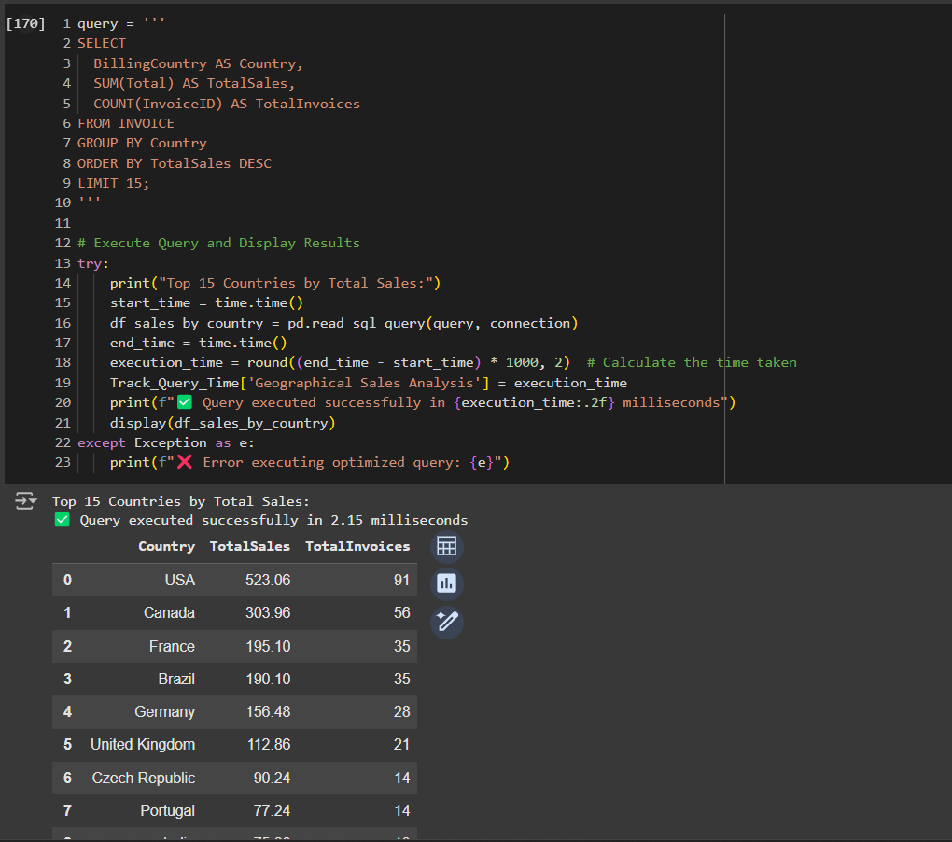
4.4 Geographical Sales Insights

Slide 28
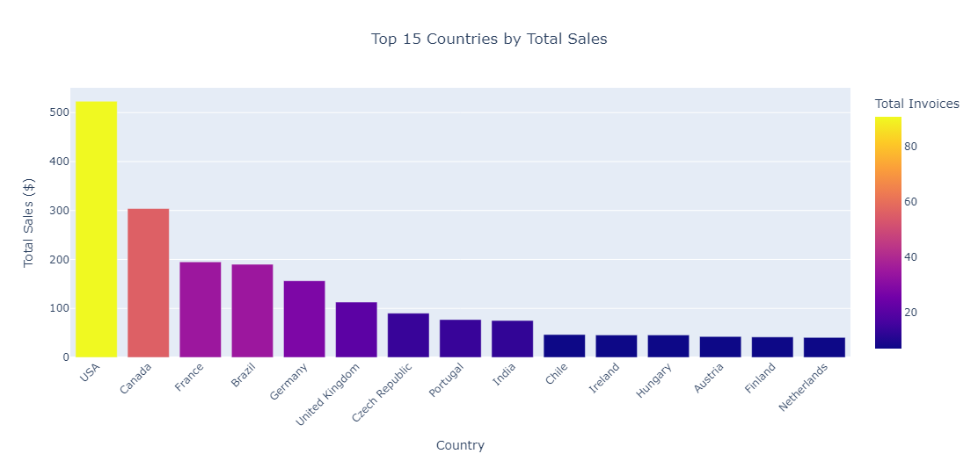
4.4 Visualizations

Slide 29
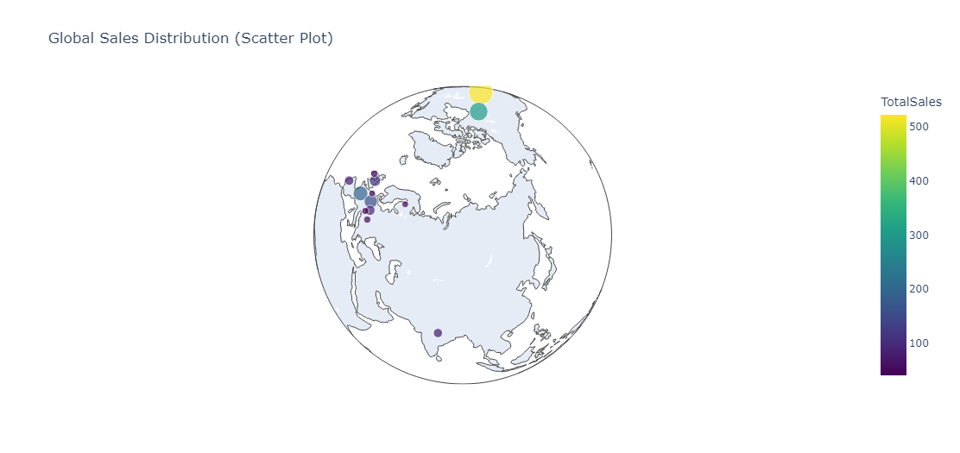
4.4 Visualizations

Slide 30
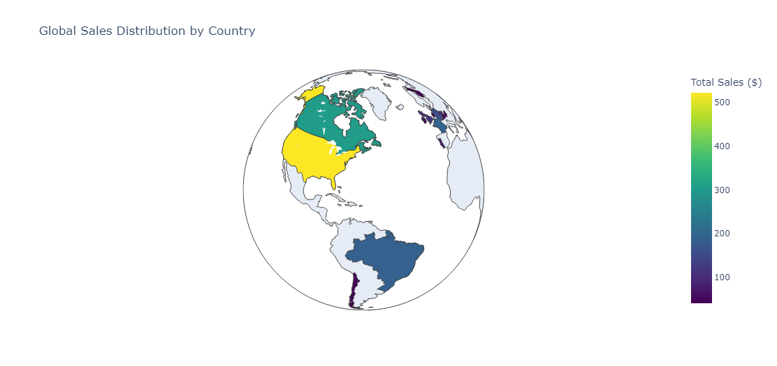
4.4 Visualizations

Slide 31
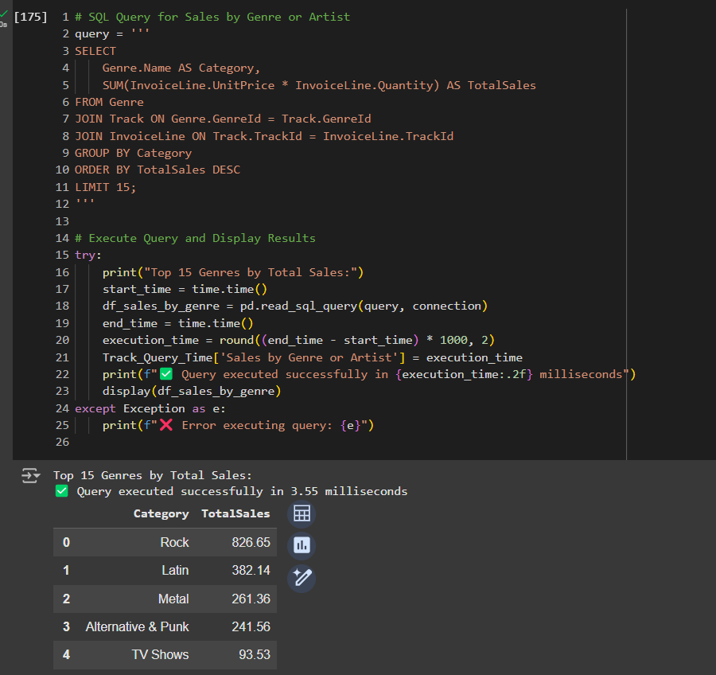
4.5 Sales by Genre or Artis

Slide 32
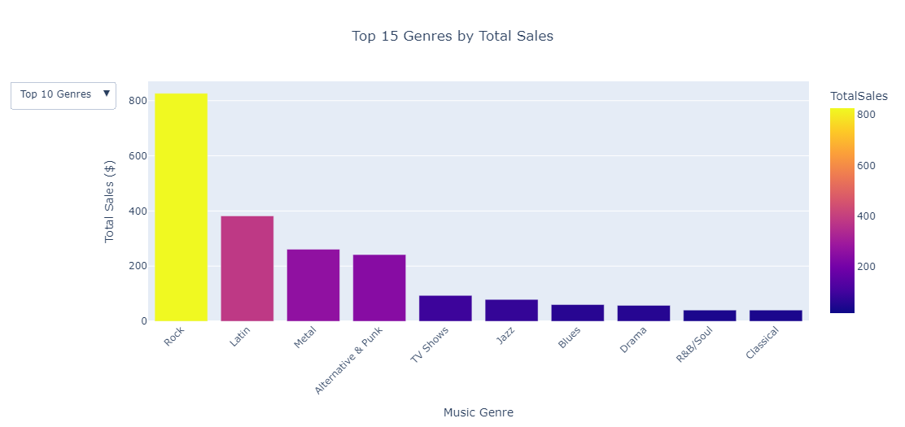
4.5 Visualizations

Slide 33
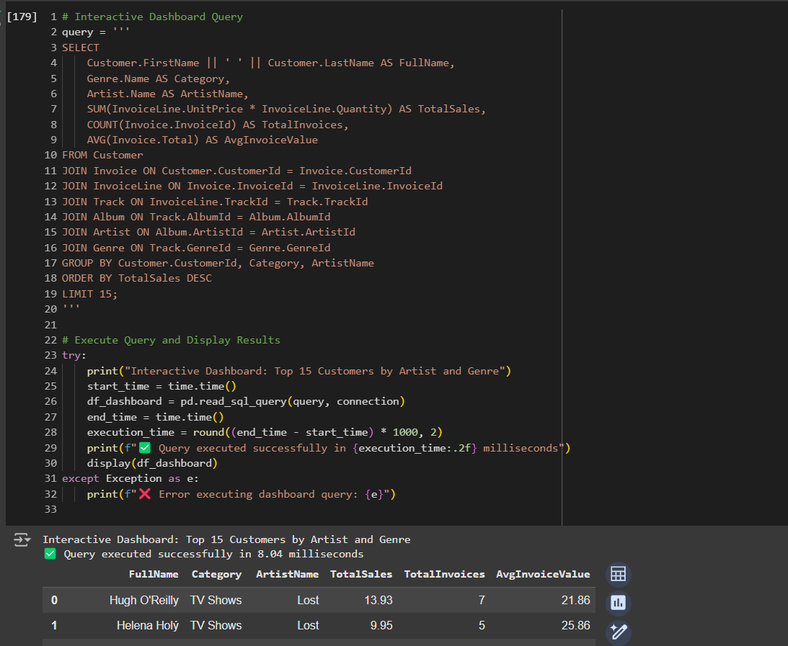
4.6 Dynamic Query Parameterization

Slide 34
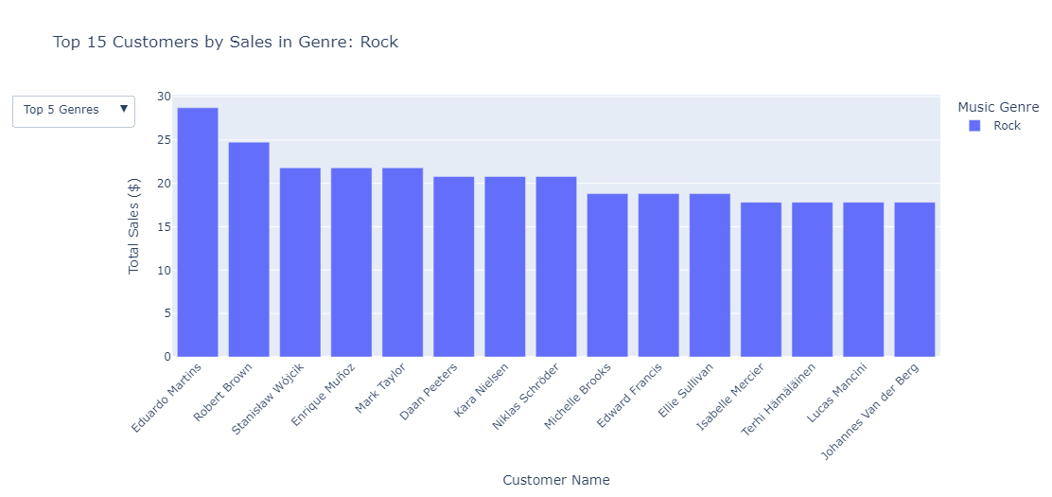
4.6 Visualizations

Slide 35
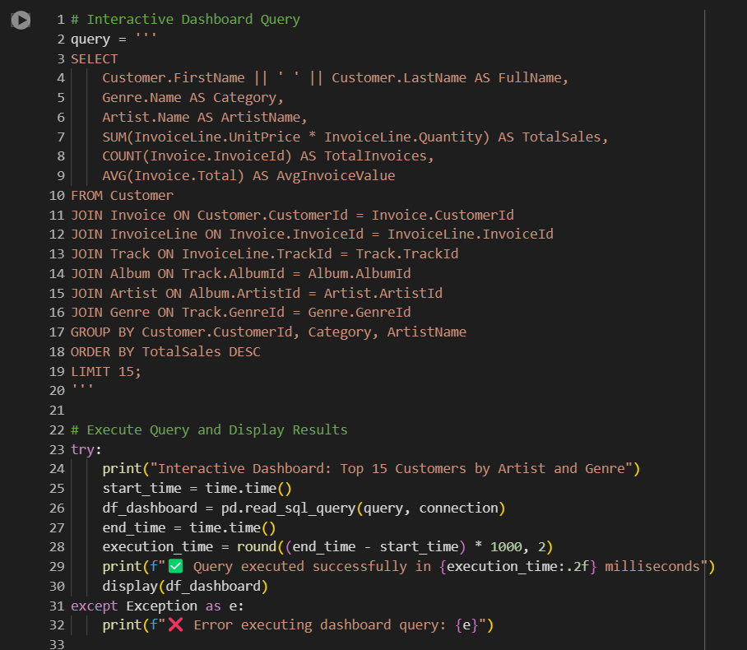
4.7 Interactive Dashboard Integration

Slide 36
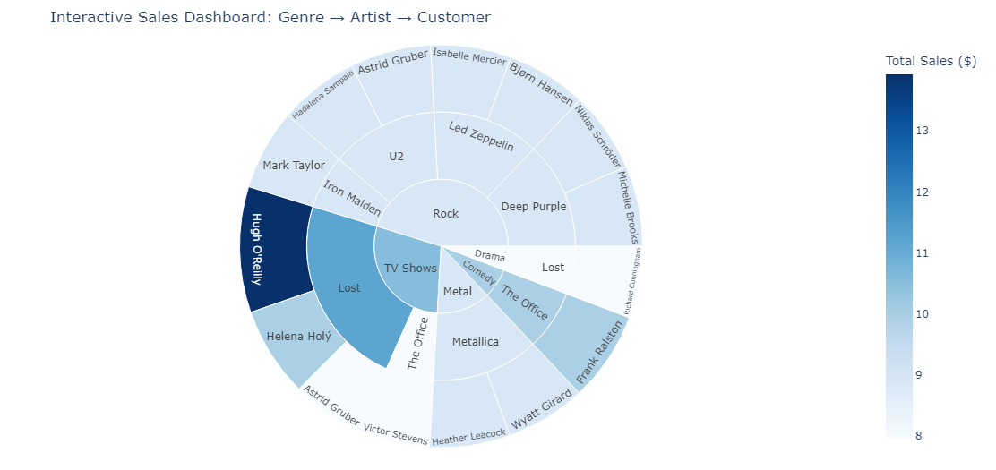
4.7 Visualizations

